Slide 1
Note Taking Skills

Slide 2
In-Class Benefits of Note Taking
Taking good notes in class is an important part of academic success in college.
Taking notes may help you focus and better understand main concepts.
Helps to improve your active listening, comprehension of material, and retention.

Slide 3
Post-Class Benefits of Good Notes
Good notes are essential for reviewing and studying class material.
Efficient and concise notes can save you time, energy, and confusion.
When watching a video, taking good notes can save time by not having to pause, rewind, and rewatch large chunks of a lecture.
Good notes can turn into great study guides!

Slide 4
Previewing Before Class
Previewing allows you to identify main ideas and concepts.
Look at your course syllabus to identify the topic/focus of the class.
Read headings and sub-headings.
Read summaries.
Review questions listed in the chapter.
Look at any pictures or charts.
Write down questions you have initially or questions you think the chapter will answer.

Slide 5
The Cornell Method

Slide 6
The Cornell Method
The Cornell note taking method helps organize class notes into easily digestible summaries. This method is effective because the main points, details, study cues, and summary are all written in one place.

Slide 7
Advantages
Notes are neatly organized, summarized, and easy to review
Allows you to pull out major ideas and concepts

Slide 8
What does it look like?
The paper is divided into 3 sections:
a 2.5” margin to the left
a 2” summary section on the bottom
a main 6” in-class note section.
Use the main notes section to take notes during class.
Use the cues section to review your notes.
After class, write down things you’ll need to remember and a prompt for each.
You can also use this section for vocabulary words and study questions.
In the summary segment at the bottom, write a summary of your notes. This is where you will highlight the main points.

Slide 11
The Outlining Method

Slide 12
The Outlining Method
An outline naturally organizes the information in a highly structured, logical manner, forming a skeleton of the textbook chapter or lecture subject that serves as an excellent study guide when preparing for tests.

Slide 13
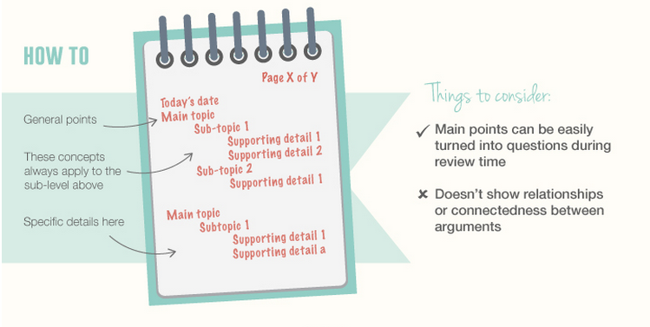
??

Slide 15
The Charting Method

Slide 16
The Charting Method
The charting method makes use of columns, dividing them into three parts to organize information. This note-taking method is most ideal for lessons that have several facts or relationships between topics.
Compared to other methods, this one is the most laid-back. Nonetheless, it’s valuable for students who like highlighting the key points on various topics to organize the facts better for easier review.

Slide 17
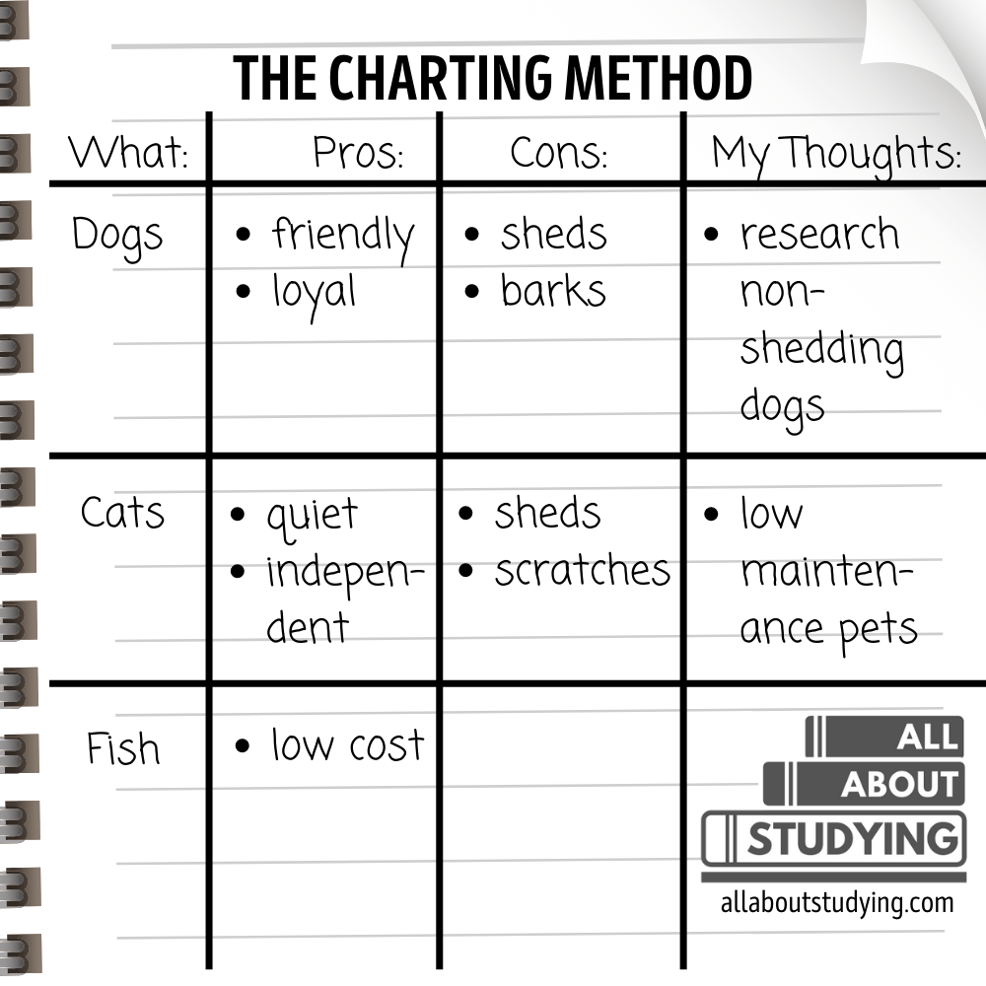
??

Slide 19
Microsoft One-Note

Slide 20
Microsoft One-Note
OneNote is a digital note-taking app that provides a single place for keeping all of your notes, research, plans, and information.
In OneNote, notebooks never run out of paper. Notes are easy to organize, print, and share, and you can search and find important information quickly, even if you forget where you've originally captured it.
Notebooks are stored online so you can easily get to them on any of your mobile devices.

Slide 21
Examples
???
??

Slide 22
Annotating Texts

Slide 23
What is an Annotation?
A systematic summary of the text that you create within the document - on the margin or within the text.
A key tool for close reading that helps you uncover patterns, notice important words, and identify main points.
An active learning strategy that improves comprehension and retention of information.

Slide 24
Why should I annotate?
Isolate and organize important material
Identify key concepts
Monitor your learning as you read
Make exam prep effective and streamlined
Can be more efficient than creating a separate set of reading notes

Slide 25
Steps
Summarize
Circle
Question
Symbol
Highlight

Slide 26
Summarize
Summarize key points in your own words.
Use headers and words in bold to guide you.
Look for main ideas, arguments, and points of evidence.
Notice how the text organizes itself. Chronological order? Idea trees? Etc.

Slide 27
Circle
What words would it be helpful to look-up at the end?
What terms show up in lecture?
When are different words used for similar concepts? Why?

Slide 28
Questions
Write questions after previewing the chapter.
Write questions after reading on important topics to use as a study guide.
Write questions if you need clarification and you want to ask your professor.

Slide 29
Symbols

Slide 30
Highlight
Only highlight after you’ve reached the end of a paragraph or a section.
Stop and think about what you read and determine the main concepts before you highlight.
Highlight key words and phrases instead of full sentences.
Color Code ﻿Definitions vs ideas

Slide 33
Thank you

Slide 34
References
"Annotating Texts." UNC Learning Center, University of North Carolina at Chapel Hill, n.d., https://learningcenter.unc.edu/tips-and-tools/annotating-texts/.
"Cornell Notes Method of Taking Notes." Youtube, uploaded by Sacramento City College Website Media, 19 May 2016, https://www.youtube.com/watch?v=lsR-10piMp4.
"Effective Note-Taking in Class." Retrieved from https://learningcenter.unc.edu/tips-and-tools/effective-note-taking-in-class/.
"How To Take Study Notes: 5 Effective Note Taking Methods." Oxford Learning. Retrieved from https://www.oxfordlearning.com/5-effective-note-taking-methods/.
"Note Taking and In-Class Skills." Virginia Tech University. Retrieved from https://www.ucc.vt.edu/academic_support/study_skills_information/note_taking_and_in-class_skills.html.
"Note Taking and In-Class Skills." Virginia Tech University. Retrieved from https://www.ucc.vt.edu/academic_support/study_skills_information/note_taking_and_in-class_skills.html.
"Tips to Highlight Your Textbook." Youtube, uploaded by WPIAccessibility, 7 Nov. 2016, https://www.youtube.com/watch?v=aYe_-89mZkg&t=3s.

